Slide 1


Full stack web design
Mini Instagram in one lesson!
12:38
In this lesson we take you through how to create a beautiful front end website (bootstrap enabled),
a MySQL database and php code. You end up with a mini version of Instagram where users can
access your site, upload their own pictures, add a description or comment and post it”
Notes:
Image source: Wikimedia Commons

Slide 2
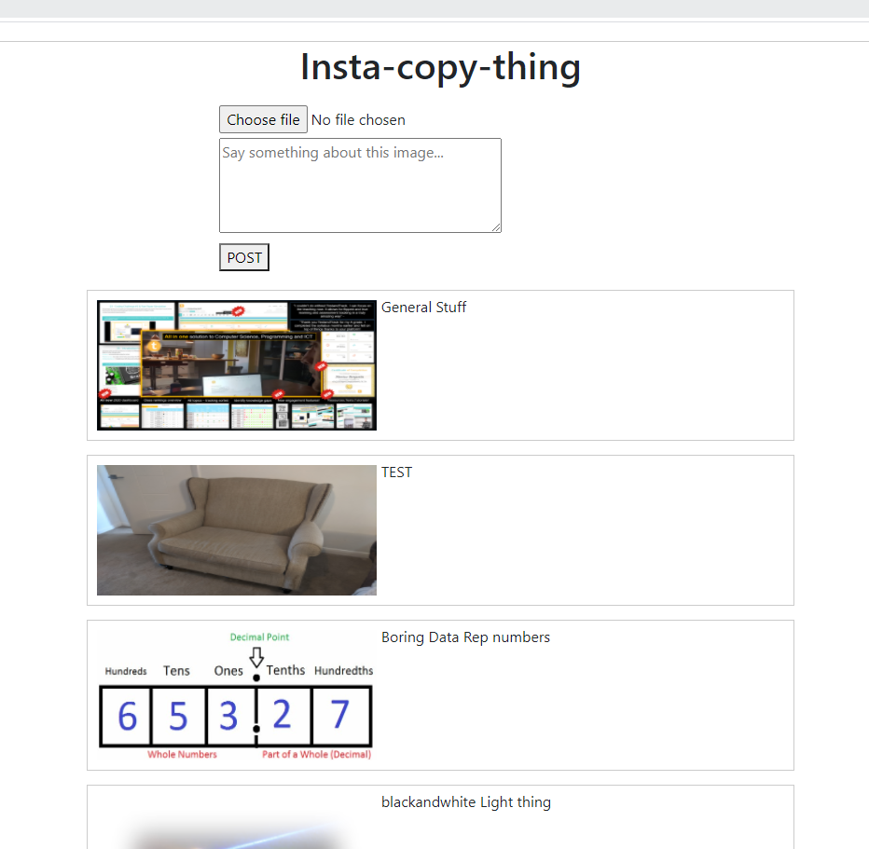
Mini Instagram in 1 lesson!
Website with the following:
-heading and some text
-Ability to select a file (image) and upload
-Ability to write something about the image
-Images uploaded are stored to an online database
-They are displayed on the page!
12:38
Notes:
<?php
// Create database connection
mysqli_report(MYSQLI_REPORT_ERROR | MYSQLI_REPORT_STRICT);
$db = mysqli_connect("fdb18.awardspace.net", "3835639_login", "open12345", "3835639_login");
// Initialize message variable
$msg = "";
// If upload button is clicked ...
if (isset($_POST['upload'])) {
// Get image name
$image = $_FILES['image']['name'];
// Get text
$image_text = mysqli_real_escape_string($db, $_POST['image_text']);
// image file directory
$target = "images/".basename($image);
$sql = "INSERT INTO image (image, image_text) VALUES ('$image', '$image_text')";
// execute query
mysqli_query($db, $sql);
if (move_uploaded_file($_FILES['image']['tmp_name'], $target)) {
$msg = "Image uploaded successfully";
}else{
$msg = "Failed to upload image";
}
}
$result = mysqli_query($db, "SELECT * FROM image");
?>
<!DOCTYPE html>
<html>
<head>
<link href="https://cdn.jsdelivr.net/npm/bootstrap@5.0.1/dist/css/bootstrap.min.css" rel="stylesheet" integrity="sha384-+0n0xVW2eSR5OomGNYDnhzAbDsOXxcvSN1TPprVMTNDbiYZCxYbOOl7+AMvyTG2x" crossorigin="anonymous">
<title>Image Upload</title>
<style type="text/css">
#content{
width: 50%;
margin: 20px auto;
border: 1px solid #cbcbcb;
}
form{
width: 50%;
margin: 20px auto;
}
form div{
margin-top: 5px;
}
#img_div{
width: 80%;
padding: 5px;
margin: 15px auto;
border: 1px solid #cbcbcb;
}
#img_div:after{
content: "";
display: block;
clear: both;
}
img{
float: left;
margin: 5px;
width: 300px;
height: 140px;
}
</style>
</head>
<body>
<div id="content">
<center> <h1>Insta-copy-thing</h1></center>
<form method="POST" action="index.php" enctype="multipart/form-data">
<input type="hidden" name="size" value="1000000">
<div>
<input type="file" name="image">
</div>
<div>
<textarea
id="text"
cols="40"
rows="4"
name="image_text"
placeholder="Say something about this image..."></textarea>
</div>
<div>
<button type="submit" name="upload">POST</button>
</div>
</form>
<?php
while ($row = mysqli_fetch_array($result)) {
echo "<div id='img_div'>";
echo "<img src='images/".$row['image']."' >";
echo "<p>".$row['image_text']."</p>";
echo "</div>";
}
?>
</div>
</body>
</html>

Slide 3
Mini Instagram in 1 lesson!
Sign up for an account with cpanel hosting (e.g Godaddy or (FREE) Awardspace.com
Create a domain name
In your public_html, add the PHP index.php file with code
Create an additional folder in your public_html called “images”
Create a database – give it a name, username and password
Create the database tables as shown (three tables, and the given fields)#
Run your site in the browser – correct any errors –and you should have a mini Instagram where users can upload pictures and comment on them!
12:38
Notes:
<?php
// Create database connection
mysqli_report(MYSQLI_REPORT_ERROR | MYSQLI_REPORT_STRICT);
$db = mysqli_connect("fdb18.awardspace.net", "3835639_login", "open12345", "3835639_login");
// Initialize message variable
$msg = "";
// If upload button is clicked ...
if (isset($_POST['upload'])) {
// Get image name
$image = $_FILES['image']['name'];
// Get text
$image_text = mysqli_real_escape_string($db, $_POST['image_text']);
// image file directory
$target = "images/".basename($image);
$sql = "INSERT INTO image (image, image_text) VALUES ('$image', '$image_text')";
// execute query
mysqli_query($db, $sql);
if (move_uploaded_file($_FILES['image']['tmp_name'], $target)) {
$msg = "Image uploaded successfully";
}else{
$msg = "Failed to upload image";
}
}
$result = mysqli_query($db, "SELECT * FROM image");
?>
<!DOCTYPE html>
<html>
<head>
<link href="https://cdn.jsdelivr.net/npm/bootstrap@5.0.1/dist/css/bootstrap.min.css" rel="stylesheet" integrity="sha384-+0n0xVW2eSR5OomGNYDnhzAbDsOXxcvSN1TPprVMTNDbiYZCxYbOOl7+AMvyTG2x" crossorigin="anonymous">
<title>Image Upload</title>
<style type="text/css">
#content{
width: 50%;
margin: 20px auto;
border: 1px solid #cbcbcb;
}
form{
width: 50%;
margin: 20px auto;
}
form div{
margin-top: 5px;
}
#img_div{
width: 80%;
padding: 5px;
margin: 15px auto;
border: 1px solid #cbcbcb;
}
#img_div:after{
content: "";
display: block;
clear: both;
}
img{
float: left;
margin: 5px;
width: 300px;
height: 140px;
}
</style>
</head>
<body>
<div id="content">
<center> <h1>Insta-copy-thing</h1></center>
<form method="POST" action="index.php" enctype="multipart/form-data">
<input type="hidden" name="size" value="1000000">
<div>
<input type="file" name="image">
</div>
<div>
<textarea
id="text"
cols="40"
rows="4"
name="image_text"
placeholder="Say something about this image..."></textarea>
</div>
<div>
<button type="submit" name="upload">POST</button>
</div>
</form>
<?php
while ($row = mysqli_fetch_array($result)) {
echo "<div id='img_div'>";
echo "<img src='images/".$row['image']."' >";
echo "<p>".$row['image_text']."</p>";
echo "</div>";
}
?>
</div>
</body>
</html>

Slide 4
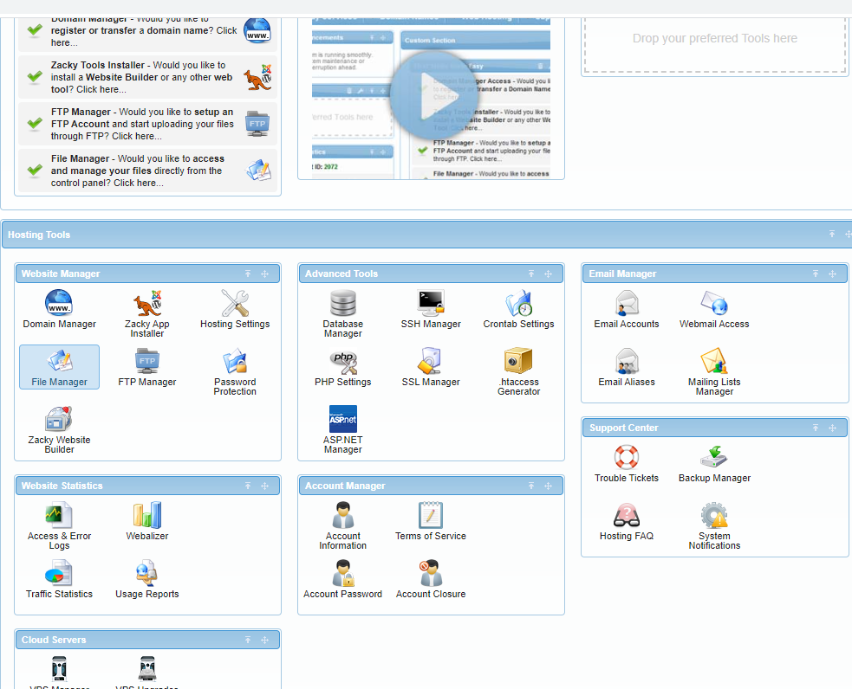
Mini Instagram in 1 lesson!
12:38
Notes:
<?php
// Create database connection
mysqli_report(MYSQLI_REPORT_ERROR | MYSQLI_REPORT_STRICT);
$db = mysqli_connect("fdb18.awardspace.net", "3835639_login", "open12345", "3835639_login");
// Initialize message variable
$msg = "";
// If upload button is clicked ...
if (isset($_POST['upload'])) {
// Get image name
$image = $_FILES['image']['name'];
// Get text
$image_text = mysqli_real_escape_string($db, $_POST['image_text']);
// image file directory
$target = "images/".basename($image);
$sql = "INSERT INTO image (image, image_text) VALUES ('$image', '$image_text')";
// execute query
mysqli_query($db, $sql);
if (move_uploaded_file($_FILES['image']['tmp_name'], $target)) {
$msg = "Image uploaded successfully";
}else{
$msg = "Failed to upload image";
}
}
$result = mysqli_query($db, "SELECT * FROM image");
?>
<!DOCTYPE html>
<html>
<head>
<link href="https://cdn.jsdelivr.net/npm/bootstrap@5.0.1/dist/css/bootstrap.min.css" rel="stylesheet" integrity="sha384-+0n0xVW2eSR5OomGNYDnhzAbDsOXxcvSN1TPprVMTNDbiYZCxYbOOl7+AMvyTG2x" crossorigin="anonymous">
<title>Image Upload</title>
<style type="text/css">
#content{
width: 50%;
margin: 20px auto;
border: 1px solid #cbcbcb;
}
form{
width: 50%;
margin: 20px auto;
}
form div{
margin-top: 5px;
}
#img_div{
width: 80%;
padding: 5px;
margin: 15px auto;
border: 1px solid #cbcbcb;
}
#img_div:after{
content: "";
display: block;
clear: both;
}
img{
float: left;
margin: 5px;
width: 300px;
height: 140px;
}
</style>
</head>
<body>
<div id="content">
<center> <h1>Insta-copy-thing</h1></center>
<form method="POST" action="index.php" enctype="multipart/form-data">
<input type="hidden" name="size" value="1000000">
<div>
<input type="file" name="image">
</div>
<div>
<textarea
id="text"
cols="40"
rows="4"
name="image_text"
placeholder="Say something about this image..."></textarea>
</div>
<div>
<button type="submit" name="upload">POST</button>
</div>
</form>
<?php
while ($row = mysqli_fetch_array($result)) {
echo "<div id='img_div'>";
echo "<img src='images/".$row['image']."' >";
echo "<p>".$row['image_text']."</p>";
echo "</div>";
}
?>
</div>
</body>
</html>

Slide 5
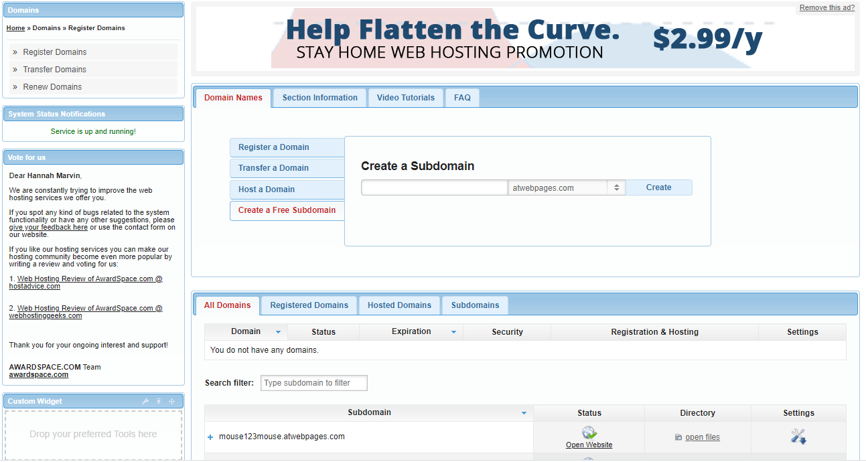
Domain name creation (Free)
12:38
Notes:
<?php
// Create database connection
mysqli_report(MYSQLI_REPORT_ERROR | MYSQLI_REPORT_STRICT);
$db = mysqli_connect("fdb18.awardspace.net", "3835639_login", "open12345", "3835639_login");
// Initialize message variable
$msg = "";
// If upload button is clicked ...
if (isset($_POST['upload'])) {
// Get image name
$image = $_FILES['image']['name'];
// Get text
$image_text = mysqli_real_escape_string($db, $_POST['image_text']);
// image file directory
$target = "images/".basename($image);
$sql = "INSERT INTO image (image, image_text) VALUES ('$image', '$image_text')";
// execute query
mysqli_query($db, $sql);
if (move_uploaded_file($_FILES['image']['tmp_name'], $target)) {
$msg = "Image uploaded successfully";
}else{
$msg = "Failed to upload image";
}
}
$result = mysqli_query($db, "SELECT * FROM image");
?>
<!DOCTYPE html>
<html>
<head>
<link href="https://cdn.jsdelivr.net/npm/bootstrap@5.0.1/dist/css/bootstrap.min.css" rel="stylesheet" integrity="sha384-+0n0xVW2eSR5OomGNYDnhzAbDsOXxcvSN1TPprVMTNDbiYZCxYbOOl7+AMvyTG2x" crossorigin="anonymous">
<title>Image Upload</title>
<style type="text/css">
#content{
width: 50%;
margin: 20px auto;
border: 1px solid #cbcbcb;
}
form{
width: 50%;
margin: 20px auto;
}
form div{
margin-top: 5px;
}
#img_div{
width: 80%;
padding: 5px;
margin: 15px auto;
border: 1px solid #cbcbcb;
}
#img_div:after{
content: "";
display: block;
clear: both;
}
img{
float: left;
margin: 5px;
width: 300px;
height: 140px;
}
</style>
</head>
<body>
<div id="content">
<center> <h1>Insta-copy-thing</h1></center>
<form method="POST" action="index.php" enctype="multipart/form-data">
<input type="hidden" name="size" value="1000000">
<div>
<input type="file" name="image">
</div>
<div>
<textarea
id="text"
cols="40"
rows="4"
name="image_text"
placeholder="Say something about this image..."></textarea>
</div>
<div>
<button type="submit" name="upload">POST</button>
</div>
</form>
<?php
while ($row = mysqli_fetch_array($result)) {
echo "<div id='img_div'>";
echo "<img src='images/".$row['image']."' >";
echo "<p>".$row['image_text']."</p>";
echo "</div>";
}
?>
</div>
</body>
</html>

Slide 6
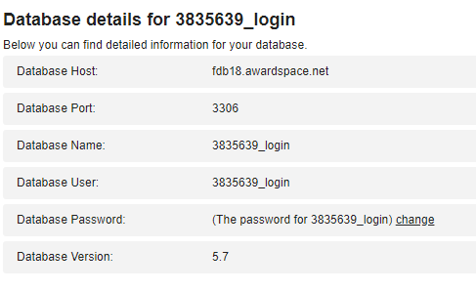
Php Code (index.php)
<?php
// Create database connection
mysqli_report(MYSQLI_REPORT_ERROR | MYSQLI_REPORT_STRICT);
$db = mysqli_connect("fdb18.awardspace.net", "3835639_login", "open12345", "3835639_login");
// Initialize message variable
$msg = "";
// If upload button is clicked ...
if (isset($_POST['upload'])) {
// Get image name
$image = $_FILES['image']['name'];
// Get text
$image_text = mysqli_real_escape_string($db, $_POST['image_text']);
// image file directory
$target = "images/".basename($image);
$sql = "INSERT INTO image (image, image_text) VALUES ('$image', '$image_text')";
// execute query
mysqli_query($db, $sql);
if (move_uploaded_file($_FILES['image']['tmp_name'], $target)) {
$msg = "Image uploaded successfully";
}else{
$msg = "Failed to upload image";
}
}
$result = mysqli_query($db, "SELECT * FROM image");
?>
<!DOCTYPE html>
<html>
<head>
<link href="https://cdn.jsdelivr.net/npm/bootstrap@5.0.1/dist/css/bootstrap.min.css" rel="stylesheet" integrity="sha384-+0n0xVW2eSR5OomGNYDnhzAbDsOXxcvSN1TPprVMTNDbiYZCxYbOOl7+AMvyTG2x" crossorigin="anonymous">
<title>Image Upload</title>
<style type="text/css">
#content{
width: 50%;
margin: 20px auto;
border: 1px solid #cbcbcb;
}
form{
width: 50%;
margin: 20px auto;
}
form div{
margin-top: 5px;
}
#img_div{
width: 80%;
padding: 5px;
margin: 15px auto;
border: 1px solid #cbcbcb;
}
#img_div:after{
content: "";
display: block;
clear: both;
}
img{
float: left;
margin: 5px;
width: 300px;
height: 140px;
}
</style>
</head>
<body>
<div id="content">
<center> <h1>Insta-copy-thing</h1></center>
<form method="POST" action="index.php" enctype="multipart/form-data">
<input type="hidden" name="size" value="1000000">
<div>
<input type="file" name="image">
</div>
<div>
<textarea
id="text"
cols="40"
rows="4"
name="image_text"
placeholder="Say something about this image..."></textarea>
</div>
<div>
<button type="submit" name="upload">POST</button>
</div>
</form>
<?php
while ($row = mysqli_fetch_array($result)) {
echo "<div id='img_div'>";
echo "<img src='images/".$row['image']."' >";
echo "<p>".$row['image_text']."</p>";
echo "</div>";
}
?>
</div>
</body>
</html>
12:38
Notes:
<?php
// Create database connection
mysqli_report(MYSQLI_REPORT_ERROR | MYSQLI_REPORT_STRICT);
$db = mysqli_connect("fdb18.awardspace.net", "3835639_login", "open12345", "3835639_login");
// Initialize message variable
$msg = "";
// If upload button is clicked ...
if (isset($_POST['upload'])) {
// Get image name
$image = $_FILES['image']['name'];
// Get text
$image_text = mysqli_real_escape_string($db, $_POST['image_text']);
// image file directory
$target = "images/".basename($image);
$sql = "INSERT INTO image (image, image_text) VALUES ('$image', '$image_text')";
// execute query
mysqli_query($db, $sql);
if (move_uploaded_file($_FILES['image']['tmp_name'], $target)) {
$msg = "Image uploaded successfully";
}else{
$msg = "Failed to upload image";
}
}
$result = mysqli_query($db, "SELECT * FROM image");
?>
<!DOCTYPE html>
<html>
<head>
<link href="https://cdn.jsdelivr.net/npm/bootstrap@5.0.1/dist/css/bootstrap.min.css" rel="stylesheet" integrity="sha384-+0n0xVW2eSR5OomGNYDnhzAbDsOXxcvSN1TPprVMTNDbiYZCxYbOOl7+AMvyTG2x" crossorigin="anonymous">
<title>Image Upload</title>
<style type="text/css">
#content{
width: 50%;
margin: 20px auto;
border: 1px solid #cbcbcb;
}
form{
width: 50%;
margin: 20px auto;
}
form div{
margin-top: 5px;
}
#img_div{
width: 80%;
padding: 5px;
margin: 15px auto;
border: 1px solid #cbcbcb;
}
#img_div:after{
content: "";
display: block;
clear: both;
}
img{
float: left;
margin: 5px;
width: 300px;
height: 140px;
}
</style>
</head>
<body>
<div id="content">
<center> <h1>Insta-copy-thing</h1></center>
<form method="POST" action="index.php" enctype="multipart/form-data">
<input type="hidden" name="size" value="1000000">
<div>
<input type="file" name="image">
</div>
<div>
<textarea
id="text"
cols="40"
rows="4"
name="image_text"
placeholder="Say something about this image..."></textarea>
</div>
<div>
<button type="submit" name="upload">POST</button>
</div>
</form>
<?php
while ($row = mysqli_fetch_array($result)) {
echo "<div id='img_div'>";
echo "<img src='images/".$row['image']."' >";
echo "<p>".$row['image_text']."</p>";
echo "</div>";
}
?>
</div>
</body>
</html>

Slide 7
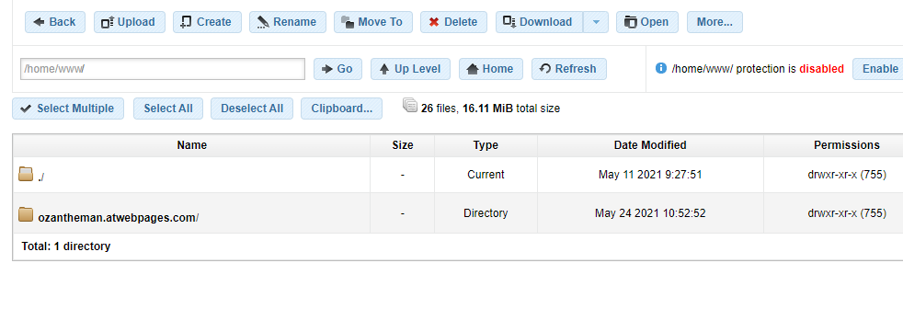
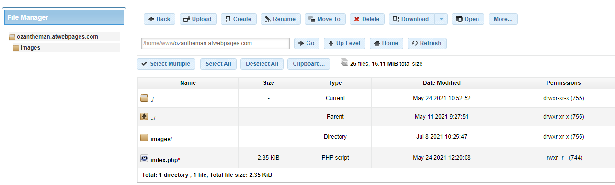
Public_html set up
12:38
Notes:
<?php
// Create database connection
mysqli_report(MYSQLI_REPORT_ERROR | MYSQLI_REPORT_STRICT);
$db = mysqli_connect("fdb18.awardspace.net", "3835639_login", "open12345", "3835639_login");
// Initialize message variable
$msg = "";
// If upload button is clicked ...
if (isset($_POST['upload'])) {
// Get image name
$image = $_FILES['image']['name'];
// Get text
$image_text = mysqli_real_escape_string($db, $_POST['image_text']);
// image file directory
$target = "images/".basename($image);
$sql = "INSERT INTO image (image, image_text) VALUES ('$image', '$image_text')";
// execute query
mysqli_query($db, $sql);
if (move_uploaded_file($_FILES['image']['tmp_name'], $target)) {
$msg = "Image uploaded successfully";
}else{
$msg = "Failed to upload image";
}
}
$result = mysqli_query($db, "SELECT * FROM image");
?>
<!DOCTYPE html>
<html>
<head>
<link href="https://cdn.jsdelivr.net/npm/bootstrap@5.0.1/dist/css/bootstrap.min.css" rel="stylesheet" integrity="sha384-+0n0xVW2eSR5OomGNYDnhzAbDsOXxcvSN1TPprVMTNDbiYZCxYbOOl7+AMvyTG2x" crossorigin="anonymous">
<title>Image Upload</title>
<style type="text/css">
#content{
width: 50%;
margin: 20px auto;
border: 1px solid #cbcbcb;
}
form{
width: 50%;
margin: 20px auto;
}
form div{
margin-top: 5px;
}
#img_div{
width: 80%;
padding: 5px;
margin: 15px auto;
border: 1px solid #cbcbcb;
}
#img_div:after{
content: "";
display: block;
clear: both;
}
img{
float: left;
margin: 5px;
width: 300px;
height: 140px;
}
</style>
</head>
<body>
<div id="content">
<center> <h1>Insta-copy-thing</h1></center>
<form method="POST" action="index.php" enctype="multipart/form-data">
<input type="hidden" name="size" value="1000000">
<div>
<input type="file" name="image">
</div>
<div>
<textarea
id="text"
cols="40"
rows="4"
name="image_text"
placeholder="Say something about this image..."></textarea>
</div>
<div>
<button type="submit" name="upload">POST</button>
</div>
</form>
<?php
while ($row = mysqli_fetch_array($result)) {
echo "<div id='img_div'>";
echo "<img src='images/".$row['image']."' >";
echo "<p>".$row['image_text']."</p>";
echo "</div>";
}
?>
</div>
</body>
</html>

Slide 8
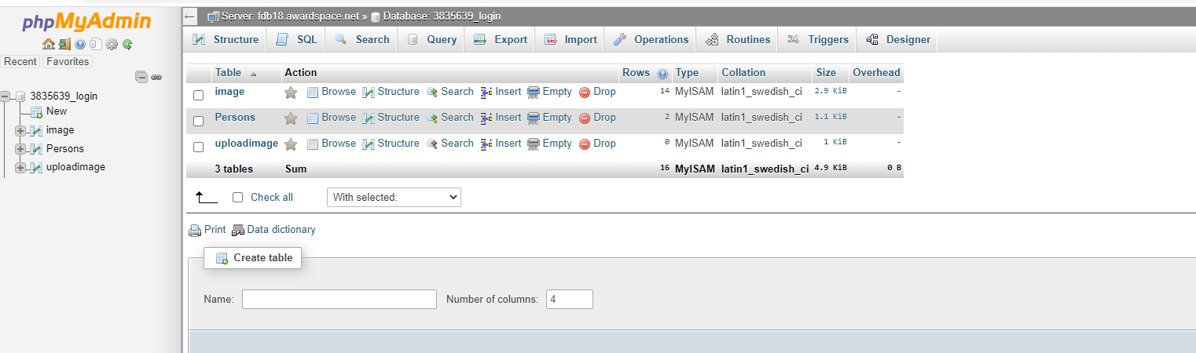
Create a Database
12:38
Notes:
<?php
// Create database connection
mysqli_report(MYSQLI_REPORT_ERROR | MYSQLI_REPORT_STRICT);
$db = mysqli_connect("fdb18.awardspace.net", "3835639_login", "open12345", "3835639_login");
// Initialize message variable
$msg = "";
// If upload button is clicked ...
if (isset($_POST['upload'])) {
// Get image name
$image = $_FILES['image']['name'];
// Get text
$image_text = mysqli_real_escape_string($db, $_POST['image_text']);
// image file directory
$target = "images/".basename($image);
$sql = "INSERT INTO image (image, image_text) VALUES ('$image', '$image_text')";
// execute query
mysqli_query($db, $sql);
if (move_uploaded_file($_FILES['image']['tmp_name'], $target)) {
$msg = "Image uploaded successfully";
}else{
$msg = "Failed to upload image";
}
}
$result = mysqli_query($db, "SELECT * FROM image");
?>
<!DOCTYPE html>
<html>
<head>
<link href="https://cdn.jsdelivr.net/npm/bootstrap@5.0.1/dist/css/bootstrap.min.css" rel="stylesheet" integrity="sha384-+0n0xVW2eSR5OomGNYDnhzAbDsOXxcvSN1TPprVMTNDbiYZCxYbOOl7+AMvyTG2x" crossorigin="anonymous">
<title>Image Upload</title>
<style type="text/css">
#content{
width: 50%;
margin: 20px auto;
border: 1px solid #cbcbcb;
}
form{
width: 50%;
margin: 20px auto;
}
form div{
margin-top: 5px;
}
#img_div{
width: 80%;
padding: 5px;
margin: 15px auto;
border: 1px solid #cbcbcb;
}
#img_div:after{
content: "";
display: block;
clear: both;
}
img{
float: left;
margin: 5px;
width: 300px;
height: 140px;
}
</style>
</head>
<body>
<div id="content">
<center> <h1>Insta-copy-thing</h1></center>
<form method="POST" action="index.php" enctype="multipart/form-data">
<input type="hidden" name="size" value="1000000">
<div>
<input type="file" name="image">
</div>
<div>
<textarea
id="text"
cols="40"
rows="4"
name="image_text"
placeholder="Say something about this image..."></textarea>
</div>
<div>
<button type="submit" name="upload">POST</button>
</div>
</form>
<?php
while ($row = mysqli_fetch_array($result)) {
echo "<div id='img_div'>";
echo "<img src='images/".$row['image']."' >";
echo "<p>".$row['image_text']."</p>";
echo "</div>";
}
?>
</div>
</body>
</html>

Slide 9
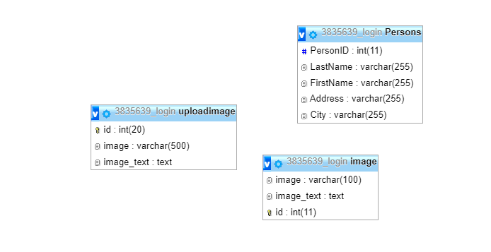
Database tables setup
12:38
Notes:
-- phpMyAdmin SQL Dump-- version 4.6.4-- https://www.phpmyadmin.net/---- Host: fdb18.awardspace.net-- Generation Time: Sep 20, 2021 at 11:39 AM-- Server version: 5.7.20-log-- PHP Version: 5.5.38SET SQL_MODE = "NO_AUTO_VALUE_ON_ZERO";SET time_zone = "+00:00";/*!40101 SET @OLD_CHARACTER_SET_CLIENT=@@CHARACTER_SET_CLIENT */;/*!40101 SET @OLD_CHARACTER_SET_RESULTS=@@CHARACTER_SET_RESULTS */;/*!40101 SET @OLD_COLLATION_CONNECTION=@@COLLATION_CONNECTION */;/*!40101 SET NAMES utf8mb4 */;---- Database: `3835639_login`---- ------------------------------------------------------------ Table structure for table `image`--CREATE TABLE `image` ( `image` varchar(100) NOT NULL, `image_text` text NOT NULL, `id` int(11) NOT NULL) ENGINE=MyISAM DEFAULT CHARSET=latin1;---- Dumping data for table `image`--INSERT INTO `image` (`image`, `image_text`, `id`) VALUES('testandtrack_allnew2020.png', 'General Stuff', 44),('2019-10-22 11.20.57.jpg', 'TEST', 45),('datarep_numbersystems_q3.jpg', 'Boring Data Rep numbers', 39),('lightthing.png', 'blackandwhite Light thing', 32),('20210605_155711.jpg', '', 49),('banner.png', 'Tech Banner', 28),('datarep_numbersystems_q3.jpg', 'Boring Data Rep numbers', 37),('image.jpg', 'This is the best laptop in the world', 47),('domeoftherock_all3.jpg', 'r;tokdlfkg;dflkgl;dgf', 48),('2019-10-22 11.20.57.jpg', 'TEST', 46),('datarep_numbersystems_q2.jpg', 'The Yuki Octal Tribe', 42),('testandtrack_allnew2020.png', 'General Stuff', 43),('stack.jpg', 'pv', 50),('cartoonman.jpg', 'https://www.testandtrack.io/aus/index.php/studenttest/test', 51);-- ------------------------------------------------------------ Table structure for table `Persons`--CREATE TABLE `Persons` ( `PersonID` int(11) DEFAULT NULL, `LastName` varchar(255) DEFAULT NULL, `FirstName` varchar(255) DEFAULT NULL, `Address` varchar(255) DEFAULT NULL, `City` varchar(255) DEFAULT NULL) ENGINE=MyISAM DEFAULT CHARSET=latin1;---- Dumping data for table `Persons`--INSERT INTO `Persons` (`PersonID`, `LastName`, `FirstName`, `Address`, `City`) VALUES(NULL, 'Marvin', 'Ruth', 'somethign', 'Caterham'),(NULL, 'Marvin', 'Ruth', 'somethign', 'Caterham');-- ------------------------------------------------------------ Table structure for table `uploadimage`--CREATE TABLE `uploadimage` ( `id` int(20) NOT NULL, `image` varchar(500) NOT NULL, `image_text` text NOT NULL) ENGINE=MyISAM DEFAULT CHARSET=latin1;---- Indexes for dumped tables------ Indexes for table `image`--ALTER TABLE `image` ADD PRIMARY KEY (`id`);---- Indexes for table `uploadimage`--ALTER TABLE `uploadimage` ADD PRIMARY KEY (`id`);---- AUTO_INCREMENT for dumped tables------ AUTO_INCREMENT for table `image`--ALTER TABLE `image` MODIFY `id` int(11) NOT NULL AUTO_INCREMENT, AUTO_INCREMENT=52;---- AUTO_INCREMENT for table `uploadimage`--ALTER TABLE `uploadimage` MODIFY `id` int(20) NOT NULL AUTO_INCREMENT;/*!40101 SET CHARACTER_SET_CLIENT=@OLD_CHARACTER_SET_CLIENT */;/*!40101 SET CHARACTER_SET_RESULTS=@OLD_CHARACTER_SET_RESULTS */;/*!40101 SET COLLATION_CONNECTION=@OLD_COLLATION_CONNECTION */;

Slide 10
…or SQL file to import
-- phpMyAdmin SQL Dump-- version 4.6.4-- https://www.phpmyadmin.net/---- Host: fdb18.awardspace.net-- Generation Time: Sep 20, 2021 at 11:39 AM-- Server version: 5.7.20-log-- PHP Version: 5.5.38SET SQL_MODE = "NO_AUTO_VALUE_ON_ZERO";SET time_zone = "+00:00";/*!40101 SET @OLD_CHARACTER_SET_CLIENT=@@CHARACTER_SET_CLIENT */;/*!40101 SET @OLD_CHARACTER_SET_RESULTS=@@CHARACTER_SET_RESULTS */;/*!40101 SET @OLD_COLLATION_CONNECTION=@@COLLATION_CONNECTION */;/*!40101 SET NAMES utf8mb4 */;---- Database: `3835639_login`---- ------------------------------------------------------------ Table structure for table `image`--CREATE TABLE `image` ( `image` varchar(100) NOT NULL, `image_text` text NOT NULL, `id` int(11) NOT NULL) ENGINE=MyISAM DEFAULT CHARSET=latin1;---- Dumping data for table `image`--INSERT INTO `image` (`image`, `image_text`, `id`) VALUES('testandtrack_allnew2020.png', 'General Stuff', 44),('2019-10-22 11.20.57.jpg', 'TEST', 45),('datarep_numbersystems_q3.jpg', 'Boring Data Rep numbers', 39),('lightthing.png', 'blackandwhite Light thing', 32),('20210605_155711.jpg', '', 49),('banner.png', 'Tech Banner', 28),('datarep_numbersystems_q3.jpg', 'Boring Data Rep numbers', 37),('image.jpg', 'This is the best laptop in the world', 47),('domeoftherock_all3.jpg', 'r;tokdlfkg;dflkgl;dgf', 48),('2019-10-22 11.20.57.jpg', 'TEST', 46),('datarep_numbersystems_q2.jpg', 'The Yuki Octal Tribe', 42),('testandtrack_allnew2020.png', 'General Stuff', 43),('stack.jpg', 'pv', 50),('cartoonman.jpg', 'https://www.testandtrack.io/aus/index.php/studenttest/test', 51);-- ------------------------------------------------------------ Table structure for table `Persons`--CREATE TABLE `Persons` ( `PersonID` int(11) DEFAULT NULL, `LastName` varchar(255) DEFAULT NULL, `FirstName` varchar(255) DEFAULT NULL, `Address` varchar(255) DEFAULT NULL, `City` varchar(255) DEFAULT NULL) ENGINE=MyISAM DEFAULT CHARSET=latin1;---- Dumping data for table `Persons`--INSERT INTO `Persons` (`PersonID`, `LastName`, `FirstName`, `Address`, `City`) VALUES(NULL, 'Marvin', 'Ruth', 'somethign', 'Caterham'),(NULL, 'Marvin', 'Ruth', 'somethign', 'Caterham');-- ------------------------------------------------------------ Table structure for table `uploadimage`--CREATE TABLE `uploadimage` ( `id` int(20) NOT NULL, `image` varchar(500) NOT NULL, `image_text` text NOT NULL) ENGINE=MyISAM DEFAULT CHARSET=latin1;---- Indexes for dumped tables------ Indexes for table `image`--ALTER TABLE `image` ADD PRIMARY KEY (`id`);---- Indexes for table `uploadimage`--ALTER TABLE `uploadimage` ADD PRIMARY KEY (`id`);---- AUTO_INCREMENT for dumped tables------ AUTO_INCREMENT for table `image`--ALTER TABLE `image` MODIFY `id` int(11) NOT NULL AUTO_INCREMENT, AUTO_INCREMENT=52;---- AUTO_INCREMENT for table `uploadimage`--ALTER TABLE `uploadimage` MODIFY `id` int(20) NOT NULL AUTO_INCREMENT;/*!40101 SET CHARACTER_SET_CLIENT=@OLD_CHARACTER_SET_CLIENT */;/*!40101 SET CHARACTER_SET_RESULTS=@OLD_CHARACTER_SET_RESULTS */;/*!40101 SET COLLATION_CONNECTION=@OLD_COLLATION_CONNECTION */;
12:38
Notes:
-- phpMyAdmin SQL Dump-- version 4.6.4-- https://www.phpmyadmin.net/---- Host: fdb18.awardspace.net-- Generation Time: Sep 20, 2021 at 11:39 AM-- Server version: 5.7.20-log-- PHP Version: 5.5.38SET SQL_MODE = "NO_AUTO_VALUE_ON_ZERO";SET time_zone = "+00:00";/*!40101 SET @OLD_CHARACTER_SET_CLIENT=@@CHARACTER_SET_CLIENT */;/*!40101 SET @OLD_CHARACTER_SET_RESULTS=@@CHARACTER_SET_RESULTS */;/*!40101 SET @OLD_COLLATION_CONNECTION=@@COLLATION_CONNECTION */;/*!40101 SET NAMES utf8mb4 */;---- Database: `3835639_login`---- ------------------------------------------------------------ Table structure for table `image`--CREATE TABLE `image` ( `image` varchar(100) NOT NULL, `image_text` text NOT NULL, `id` int(11) NOT NULL) ENGINE=MyISAM DEFAULT CHARSET=latin1;---- Dumping data for table `image`--INSERT INTO `image` (`image`, `image_text`, `id`) VALUES('testandtrack_allnew2020.png', 'General Stuff', 44),('2019-10-22 11.20.57.jpg', 'TEST', 45),('datarep_numbersystems_q3.jpg', 'Boring Data Rep numbers', 39),('lightthing.png', 'blackandwhite Light thing', 32),('20210605_155711.jpg', '', 49),('banner.png', 'Tech Banner', 28),('datarep_numbersystems_q3.jpg', 'Boring Data Rep numbers', 37),('image.jpg', 'This is the best laptop in the world', 47),('domeoftherock_all3.jpg', 'r;tokdlfkg;dflkgl;dgf', 48),('2019-10-22 11.20.57.jpg', 'TEST', 46),('datarep_numbersystems_q2.jpg', 'The Yuki Octal Tribe', 42),('testandtrack_allnew2020.png', 'General Stuff', 43),('stack.jpg', 'pv', 50),('cartoonman.jpg', 'https://www.testandtrack.io/aus/index.php/studenttest/test', 51);-- ------------------------------------------------------------ Table structure for table `Persons`--CREATE TABLE `Persons` ( `PersonID` int(11) DEFAULT NULL, `LastName` varchar(255) DEFAULT NULL, `FirstName` varchar(255) DEFAULT NULL, `Address` varchar(255) DEFAULT NULL, `City` varchar(255) DEFAULT NULL) ENGINE=MyISAM DEFAULT CHARSET=latin1;---- Dumping data for table `Persons`--INSERT INTO `Persons` (`PersonID`, `LastName`, `FirstName`, `Address`, `City`) VALUES(NULL, 'Marvin', 'Ruth', 'somethign', 'Caterham'),(NULL, 'Marvin', 'Ruth', 'somethign', 'Caterham');-- ------------------------------------------------------------ Table structure for table `uploadimage`--CREATE TABLE `uploadimage` ( `id` int(20) NOT NULL, `image` varchar(500) NOT NULL, `image_text` text NOT NULL) ENGINE=MyISAM DEFAULT CHARSET=latin1;---- Indexes for dumped tables------ Indexes for table `image`--ALTER TABLE `image` ADD PRIMARY KEY (`id`);---- Indexes for table `uploadimage`--ALTER TABLE `uploadimage` ADD PRIMARY KEY (`id`);---- AUTO_INCREMENT for dumped tables------ AUTO_INCREMENT for table `image`--ALTER TABLE `image` MODIFY `id` int(11) NOT NULL AUTO_INCREMENT, AUTO_INCREMENT=52;---- AUTO_INCREMENT for table `uploadimage`--ALTER TABLE `uploadimage` MODIFY `id` int(20) NOT NULL AUTO_INCREMENT;/*!40101 SET CHARACTER_SET_CLIENT=@OLD_CHARACTER_SET_CLIENT */;/*!40101 SET CHARACTER_SET_RESULTS=@OLD_CHARACTER_SET_RESULTS */;/*!40101 SET COLLATION_CONNECTION=@OLD_COLLATION_CONNECTION */;

Slide 11
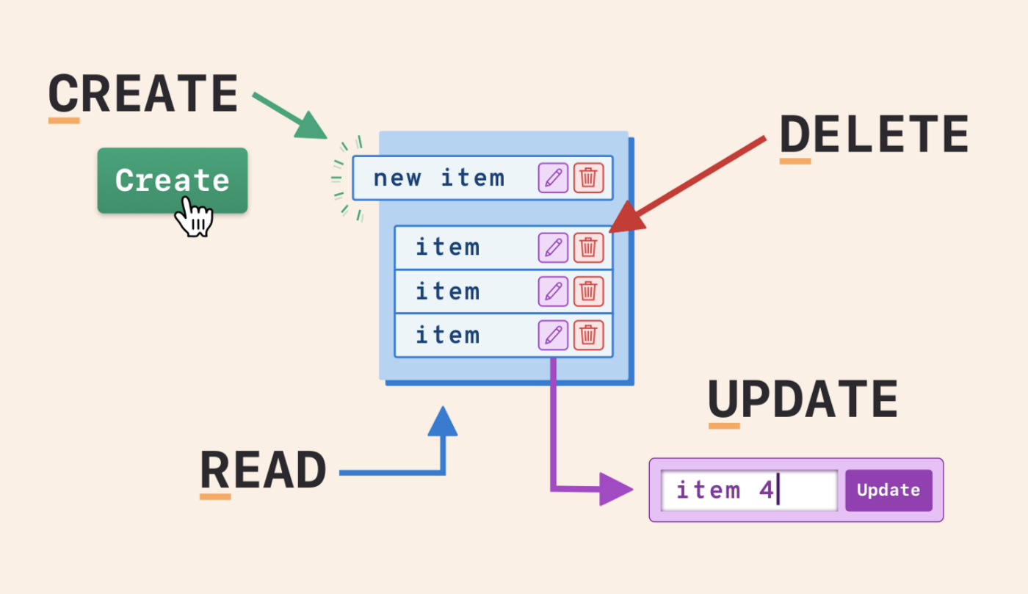
Challenge: Add CRUD functionality!
12:38
Notes:
-- phpMyAdmin SQL Dump-- version 4.6.4-- https://www.phpmyadmin.net/---- Host: fdb18.awardspace.net-- Generation Time: Sep 20, 2021 at 11:39 AM-- Server version: 5.7.20-log-- PHP Version: 5.5.38SET SQL_MODE = "NO_AUTO_VALUE_ON_ZERO";SET time_zone = "+00:00";/*!40101 SET @OLD_CHARACTER_SET_CLIENT=@@CHARACTER_SET_CLIENT */;/*!40101 SET @OLD_CHARACTER_SET_RESULTS=@@CHARACTER_SET_RESULTS */;/*!40101 SET @OLD_COLLATION_CONNECTION=@@COLLATION_CONNECTION */;/*!40101 SET NAMES utf8mb4 */;---- Database: `3835639_login`---- ------------------------------------------------------------ Table structure for table `image`--CREATE TABLE `image` ( `image` varchar(100) NOT NULL, `image_text` text NOT NULL, `id` int(11) NOT NULL) ENGINE=MyISAM DEFAULT CHARSET=latin1;---- Dumping data for table `image`--INSERT INTO `image` (`image`, `image_text`, `id`) VALUES('testandtrack_allnew2020.png', 'General Stuff', 44),('2019-10-22 11.20.57.jpg', 'TEST', 45),('datarep_numbersystems_q3.jpg', 'Boring Data Rep numbers', 39),('lightthing.png', 'blackandwhite Light thing', 32),('20210605_155711.jpg', '', 49),('banner.png', 'Tech Banner', 28),('datarep_numbersystems_q3.jpg', 'Boring Data Rep numbers', 37),('image.jpg', 'This is the best laptop in the world', 47),('domeoftherock_all3.jpg', 'r;tokdlfkg;dflkgl;dgf', 48),('2019-10-22 11.20.57.jpg', 'TEST', 46),('datarep_numbersystems_q2.jpg', 'The Yuki Octal Tribe', 42),('testandtrack_allnew2020.png', 'General Stuff', 43),('stack.jpg', 'pv', 50),('cartoonman.jpg', 'https://www.testandtrack.io/aus/index.php/studenttest/test', 51);-- ------------------------------------------------------------ Table structure for table `Persons`--CREATE TABLE `Persons` ( `PersonID` int(11) DEFAULT NULL, `LastName` varchar(255) DEFAULT NULL, `FirstName` varchar(255) DEFAULT NULL, `Address` varchar(255) DEFAULT NULL, `City` varchar(255) DEFAULT NULL) ENGINE=MyISAM DEFAULT CHARSET=latin1;---- Dumping data for table `Persons`--INSERT INTO `Persons` (`PersonID`, `LastName`, `FirstName`, `Address`, `City`) VALUES(NULL, 'Marvin', 'Ruth', 'somethign', 'Caterham'),(NULL, 'Marvin', 'Ruth', 'somethign', 'Caterham');-- ------------------------------------------------------------ Table structure for table `uploadimage`--CREATE TABLE `uploadimage` ( `id` int(20) NOT NULL, `image` varchar(500) NOT NULL, `image_text` text NOT NULL) ENGINE=MyISAM DEFAULT CHARSET=latin1;---- Indexes for dumped tables------ Indexes for table `image`--ALTER TABLE `image` ADD PRIMARY KEY (`id`);---- Indexes for table `uploadimage`--ALTER TABLE `uploadimage` ADD PRIMARY KEY (`id`);---- AUTO_INCREMENT for dumped tables------ AUTO_INCREMENT for table `image`--ALTER TABLE `image` MODIFY `id` int(11) NOT NULL AUTO_INCREMENT, AUTO_INCREMENT=52;---- AUTO_INCREMENT for table `uploadimage`--ALTER TABLE `uploadimage` MODIFY `id` int(20) NOT NULL AUTO_INCREMENT;/*!40101 SET CHARACTER_SET_CLIENT=@OLD_CHARACTER_SET_CLIENT */;/*!40101 SET CHARACTER_SET_RESULTS=@OLD_CHARACTER_SET_RESULTS */;/*!40101 SET COLLATION_CONNECTION=@OLD_COLLATION_CONNECTION */;

Slide 12
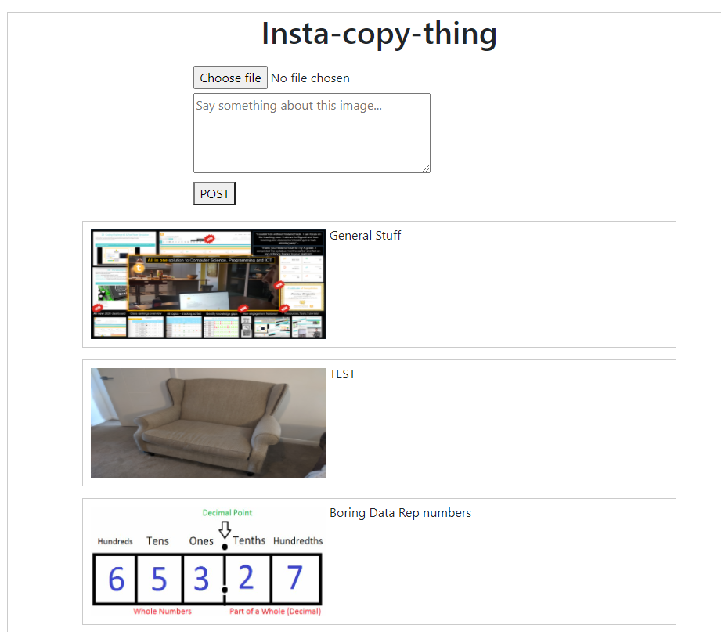
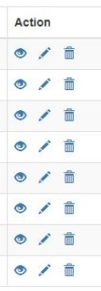
Challenge: Add CRUD functionality!
12:38
Notes:
-- phpMyAdmin SQL Dump-- version 4.6.4-- https://www.phpmyadmin.net/---- Host: fdb18.awardspace.net-- Generation Time: Sep 20, 2021 at 11:39 AM-- Server version: 5.7.20-log-- PHP Version: 5.5.38SET SQL_MODE = "NO_AUTO_VALUE_ON_ZERO";SET time_zone = "+00:00";/*!40101 SET @OLD_CHARACTER_SET_CLIENT=@@CHARACTER_SET_CLIENT */;/*!40101 SET @OLD_CHARACTER_SET_RESULTS=@@CHARACTER_SET_RESULTS */;/*!40101 SET @OLD_COLLATION_CONNECTION=@@COLLATION_CONNECTION */;/*!40101 SET NAMES utf8mb4 */;---- Database: `3835639_login`---- ------------------------------------------------------------ Table structure for table `image`--CREATE TABLE `image` ( `image` varchar(100) NOT NULL, `image_text` text NOT NULL, `id` int(11) NOT NULL) ENGINE=MyISAM DEFAULT CHARSET=latin1;---- Dumping data for table `image`--INSERT INTO `image` (`image`, `image_text`, `id`) VALUES('testandtrack_allnew2020.png', 'General Stuff', 44),('2019-10-22 11.20.57.jpg', 'TEST', 45),('datarep_numbersystems_q3.jpg', 'Boring Data Rep numbers', 39),('lightthing.png', 'blackandwhite Light thing', 32),('20210605_155711.jpg', '', 49),('banner.png', 'Tech Banner', 28),('datarep_numbersystems_q3.jpg', 'Boring Data Rep numbers', 37),('image.jpg', 'This is the best laptop in the world', 47),('domeoftherock_all3.jpg', 'r;tokdlfkg;dflkgl;dgf', 48),('2019-10-22 11.20.57.jpg', 'TEST', 46),('datarep_numbersystems_q2.jpg', 'The Yuki Octal Tribe', 42),('testandtrack_allnew2020.png', 'General Stuff', 43),('stack.jpg', 'pv', 50),('cartoonman.jpg', 'https://www.testandtrack.io/aus/index.php/studenttest/test', 51);-- ------------------------------------------------------------ Table structure for table `Persons`--CREATE TABLE `Persons` ( `PersonID` int(11) DEFAULT NULL, `LastName` varchar(255) DEFAULT NULL, `FirstName` varchar(255) DEFAULT NULL, `Address` varchar(255) DEFAULT NULL, `City` varchar(255) DEFAULT NULL) ENGINE=MyISAM DEFAULT CHARSET=latin1;---- Dumping data for table `Persons`--INSERT INTO `Persons` (`PersonID`, `LastName`, `FirstName`, `Address`, `City`) VALUES(NULL, 'Marvin', 'Ruth', 'somethign', 'Caterham'),(NULL, 'Marvin', 'Ruth', 'somethign', 'Caterham');-- ------------------------------------------------------------ Table structure for table `uploadimage`--CREATE TABLE `uploadimage` ( `id` int(20) NOT NULL, `image` varchar(500) NOT NULL, `image_text` text NOT NULL) ENGINE=MyISAM DEFAULT CHARSET=latin1;---- Indexes for dumped tables------ Indexes for table `image`--ALTER TABLE `image` ADD PRIMARY KEY (`id`);---- Indexes for table `uploadimage`--ALTER TABLE `uploadimage` ADD PRIMARY KEY (`id`);---- AUTO_INCREMENT for dumped tables------ AUTO_INCREMENT for table `image`--ALTER TABLE `image` MODIFY `id` int(11) NOT NULL AUTO_INCREMENT, AUTO_INCREMENT=52;---- AUTO_INCREMENT for table `uploadimage`--ALTER TABLE `uploadimage` MODIFY `id` int(20) NOT NULL AUTO_INCREMENT;/*!40101 SET CHARACTER_SET_CLIENT=@OLD_CHARACTER_SET_CLIENT */;/*!40101 SET CHARACTER_SET_RESULTS=@OLD_CHARACTER_SET_RESULTS */;/*!40101 SET COLLATION_CONNECTION=@OLD_COLLATION_CONNECTION */;

